Slide 1


Dynamic Graph Isomorphism
M. Abdullah Siddiqui - 23I-0617
M. Daniyal - 23I-0579
Moiz Ansari - 23I-0523

Slide 2
PROBLEM SOLVED BY OBEROI & TEAM
Static graph could only compare on a specific instances.
Introduced dynamic graph isomorphism .
It make comparisons over time.
Notes:
In static graph we could only compare on a specific instance.
Oberoi solved this problem and introduced dynamic graph isomorphism which evolved over time to make comparisons of graphs that change over time.

Slide 3
DIFFERENCE IN SOLUTION
In previous sol we used timestamp whenever a pass is happened in a edge.
In Oberoi sol snapshots are taken and the graph is evolved over time.
This is a chronological order.
Notes:
In previous solution there was a concept of timestamp that when a pass happened it makes a timestamp at that edge.
But in Oberoi solution, the concept of snapshot based model is used in which graphs at different times are compared.
More precise and chronological order comparison.

Slide 4
BETTER SOLUTION
Comparison with Mackey and Temporal RI algorithm.
It has a better run time and success rate for the subgraph isomorphism.
Runs better at large data sets.
Notes:
Comparison with Mackey and TemporalRl algorithms
Better runtime and success rate for subgraph isomorphism
Runs better at large data sets

Slide 5
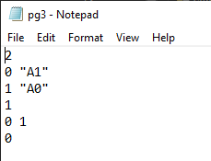
Input File

Slide 6
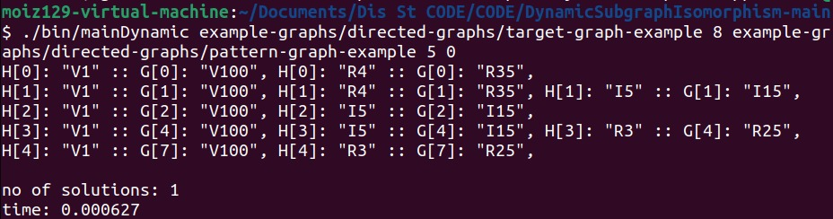
CODE RUNNING (Output)

Slide 7
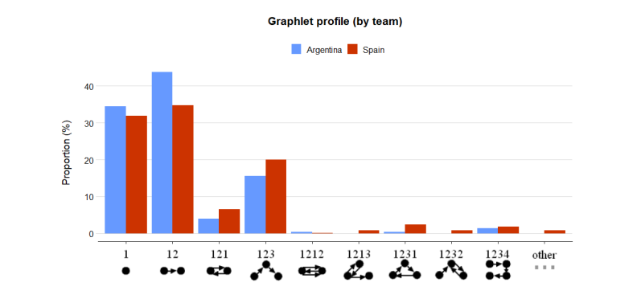
BOURGEAS PAPER: FIG 3
State Entropy
Probability of state changing
Probability in percentage
Different passing techniques

Slide 8
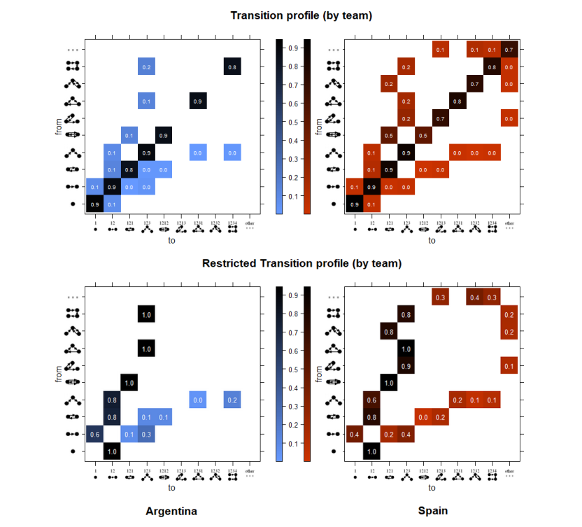
BOURGEAS PAPER: FIG 4
Transition Entropy
Probability of state changing
Probability between 0-1
Reading graph by Row-Column

